Slide 1
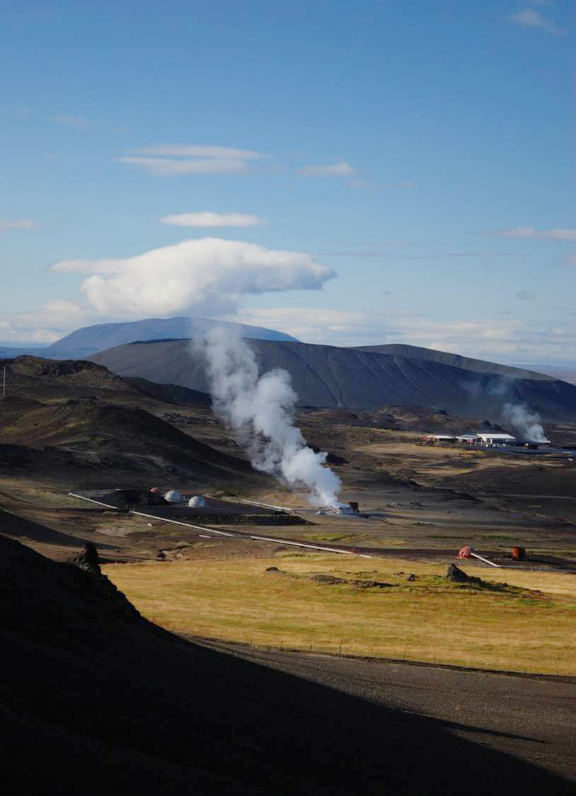

NETL NRAP Reservoir workgroup overview
Seth King
Research Scientist, URS
October 23, 2014

Slide 2
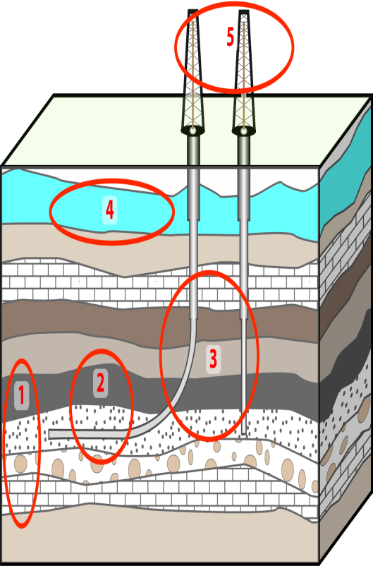
Outline
Smith Analysis Group
Building metrics of reservoir performance associated to risk
ROM development
Components of integrated assessment models (IAMs) used to probe uncertainties
Surrogate Reservoir Model (SRM)
Polynomial Chaos Expansion (PCE)

Slide 3
Smith Analysis Group General Focus/Approach
What we’re doing
Developing a synthetic database of reservoir behavior to inform two questions:
How does reservoir performance change as a function of injection volumes & rates?
How does a reservoir respond as a function of time when injection stops?
What we’ve done…
Explored behavior of a few prototype reservoirs as a function of operational and geological variables using physics-based simulations
Used three reservoir performance metrics that relate to potential risks of concern (i.e., not a direct measure of risk)
Size of CO2 Plume
Size of Pressure Plume
Change in Pressure over Time (at a Point)
Monitored metrics using simple parameters; threshold values for pressure reflect a range from small increase through thresholds with potential to cause impact

Slide 4
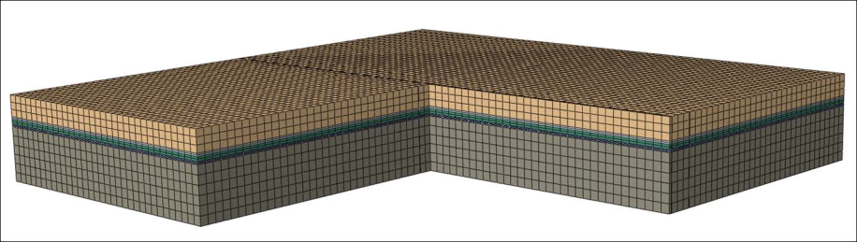
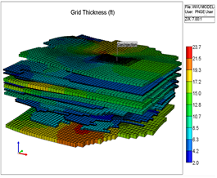
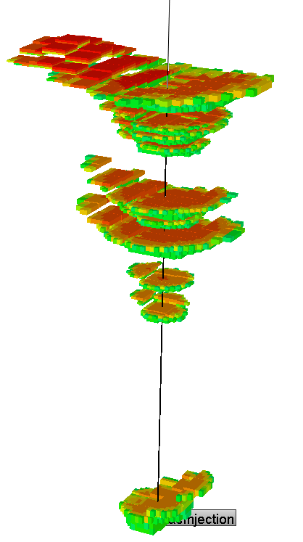
Overview of Detailed Simulations
Multiple reservoir types
Unbound sandstone formation (regional dip), homogeneous, varying permeability
Multilayer, domal sandstone reservoir (based on Citronelle), history matched
Domal, sandstone & limestone (based on Rock Springs Uplift), heterogeneous, multiple injectors
Operational parameters considered
Constant-rate injection
Varying Injection rates (10kt to 5Mt/yr)
Varying Injection times (3 to 30 years)
Post Injection: Monitoring pressures and CO2 at various time points (from 20 to 200 years, based on size of injection)
Subsurface parameters considered
Permeability; permeability ratio (kh:kv); porosity; compressibility; salinity; model domain size; formation thickness and surrounding permeability
Results based on >1000 detailed simulations
Continuum scale reservoir simulators
Full, 3D simulations; no chemistry; no mechanics beyond compressibility
Simulation times hours to days

Slide 5
Reservoirs Considered
Unbound sandstone: Regional Dip
LBNL Team (Zhang et al.) simulated using TOUGH2 and TP3D
General unstructured, dipping sandstone reservoir
Runs varying specific parameters
Multi-layer, domal sandstone
NETL Team (Fathi et al.) simulated using CMG
Derived from Citronelle, history-match model
Two models: detailed but small domain; generalized but larger domain
Runs varying specific parameters
Domal, dipping sandstone-limestone
LANL Team (Dempsey et al.) simulated using FEHM
Derived from Rock-Springs Uplift site model
Runs varying geologic heterogeneity & other parameters
Unbound sandstone
LANL Team (Dempsey et al.) simulated using FEHM
General unstructured flat sandstone aquifer
Stochastic evaluation for specific parameters

Slide 6
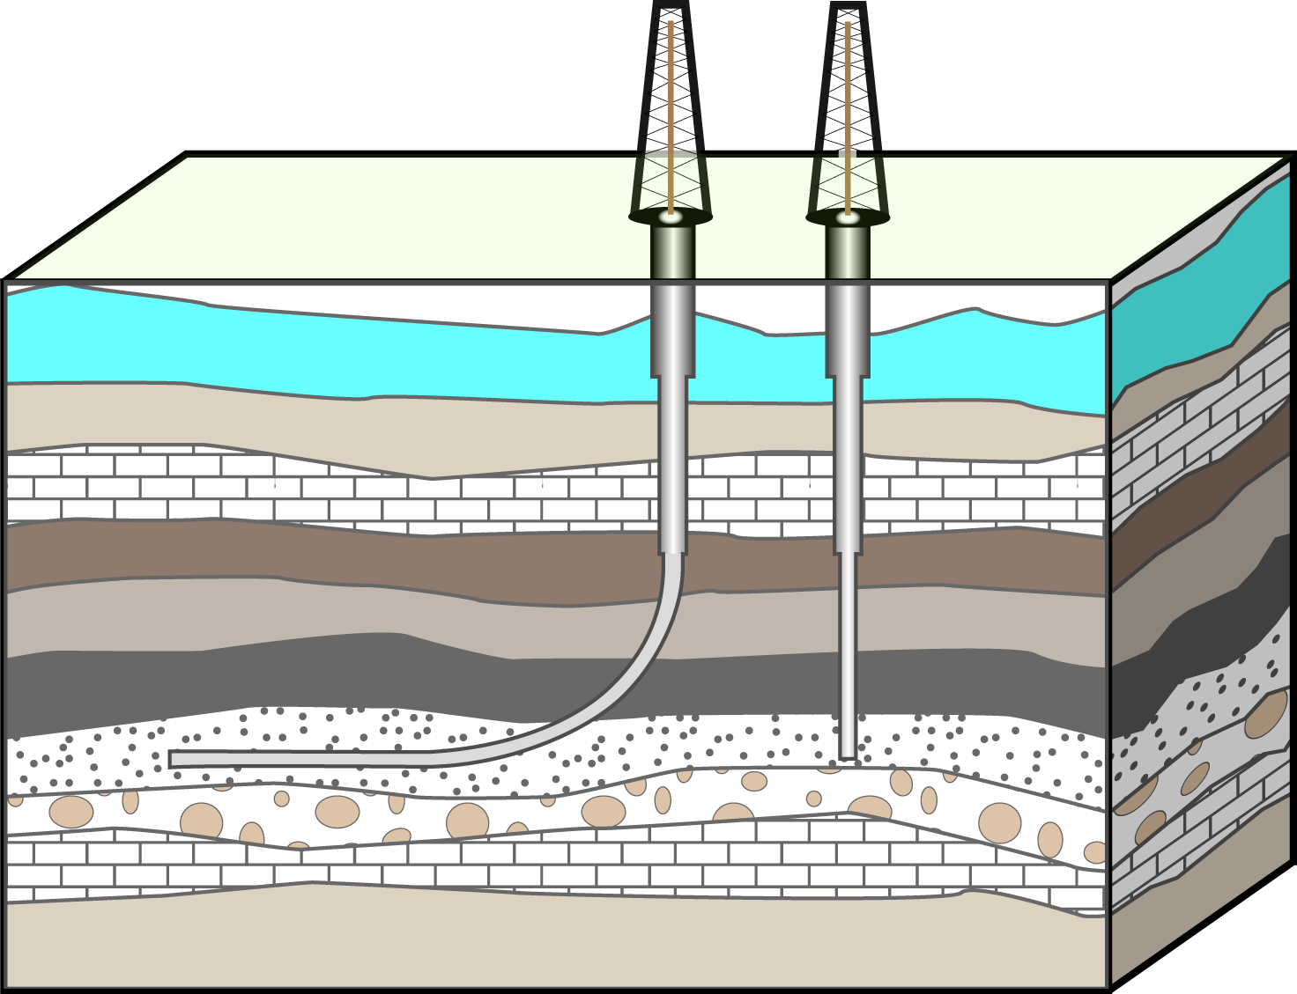
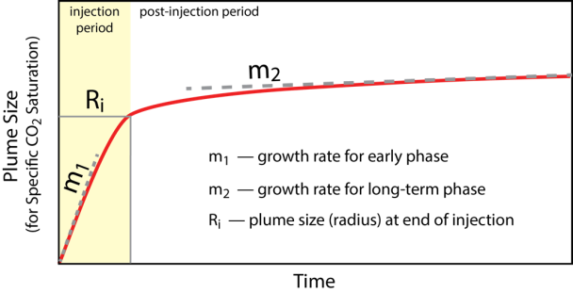
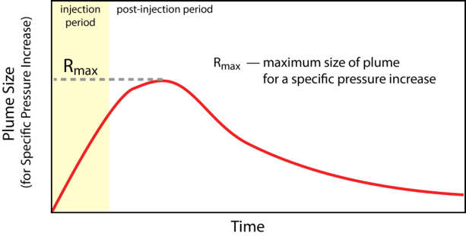
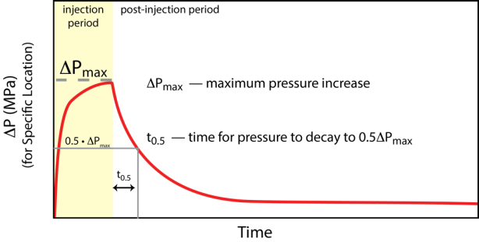
Metrics Analyzed
Size of CO₂ plume injection
Rate of growth for early phase
Rate of growth for long-term phase
Plume radius at end of injection
Size of pressure plume
Maximum size of plume
Various pressure thresholds
Brine rise
Fault-slip criteria
Pressure at a location
Maximum pressure increase
Size of CO₂ Plume
Size of Pressure Plume
Pressure at at a Location

Slide 7
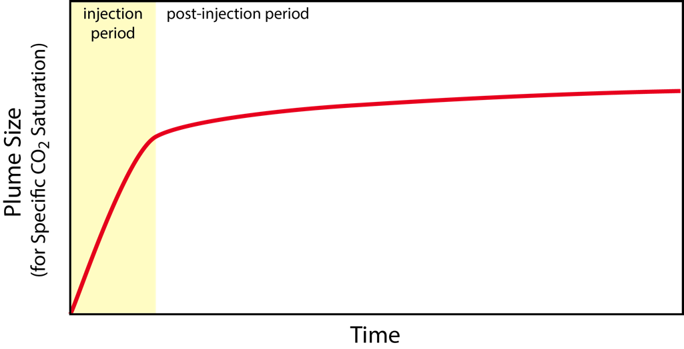
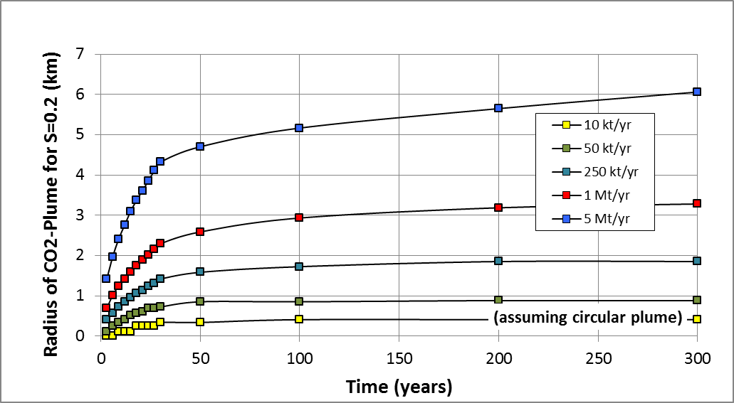
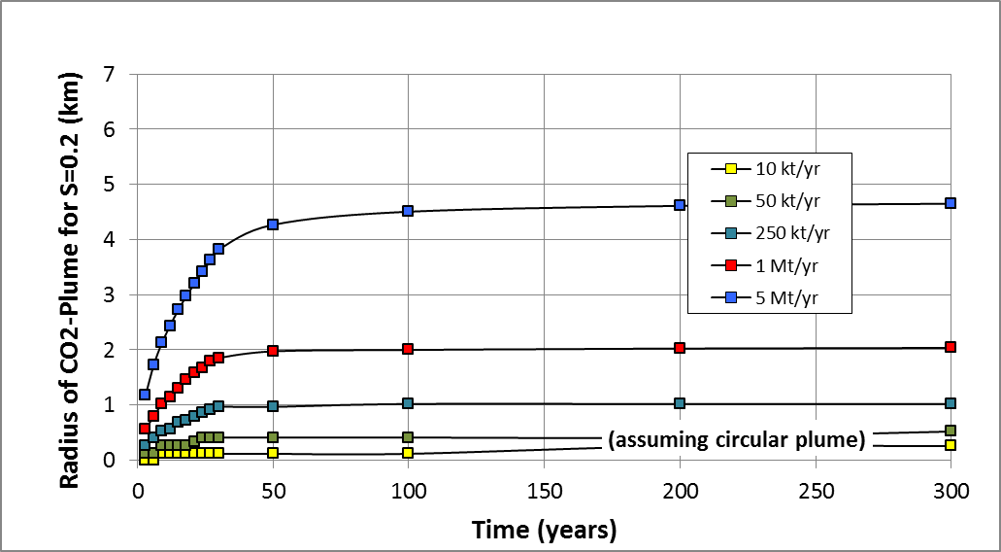
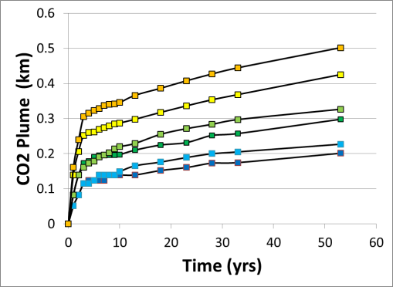
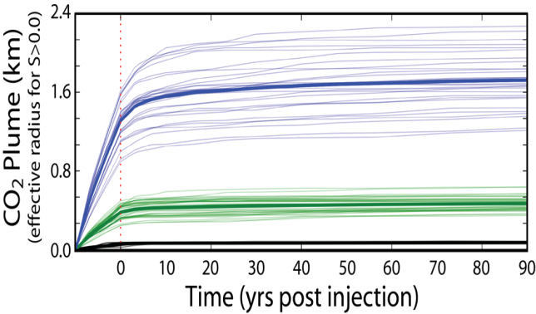
Growth of CO₂ plume has a characteristic behavior, albeit details vary between sites.
Unbound Sandstone, Regional Dip (0° dip; k_{h}=100 mD; φ=0.2)
post-injection: slow growth to stable
injection: rapid growth
Unbound Sandstone, Regional Dip (0° dip; k_{h}=1000 mD; φ=0.2)
Multi-layer, Domal Sandstone (3-yr injection; 0.1-10 Mt)
Domal Sandstone-Limestone (10-yr injection; 1-50 Mt)

Slide 8
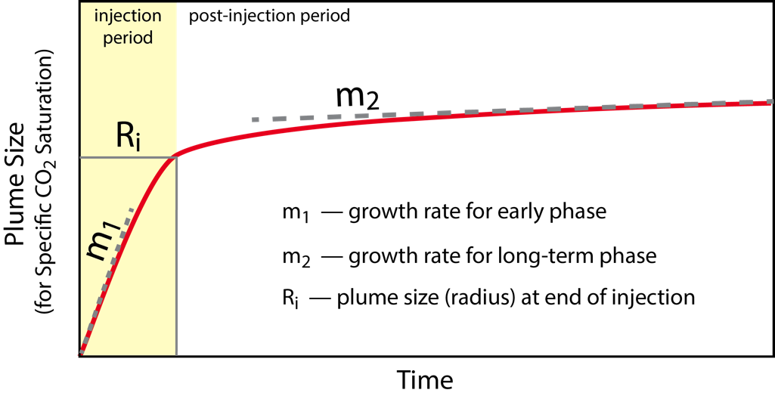
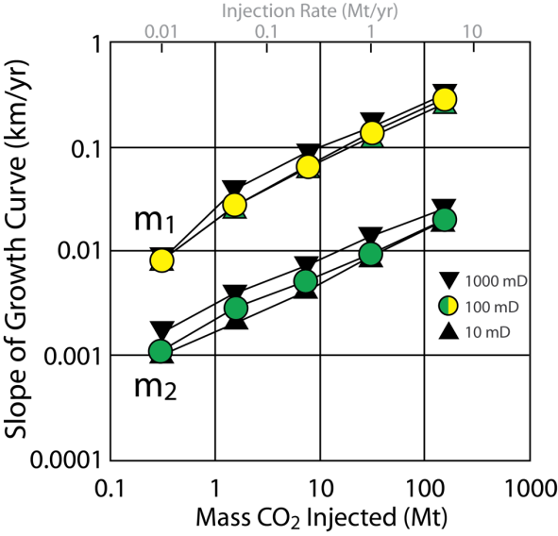
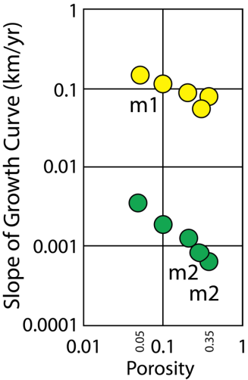
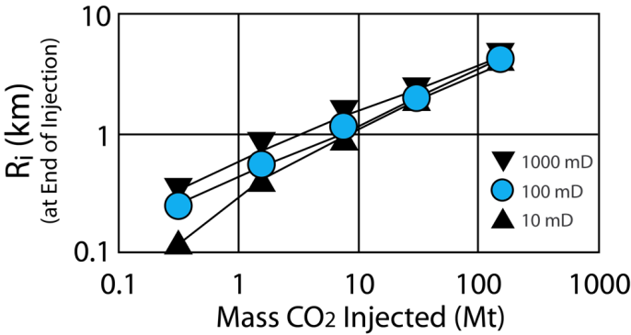
Amount of CO₂ injected is primary factor in the growth rate and size of CO₂ plume.
Unbound Sandstone, Regional Dip
(1° dip; 1Mt/yr)
Unbound Sandstone, Regional Dip (0° dip)
Increase in mass of CO₂ increases the growth rate for the CO₂ plume (both early and long-term rates)
Increase in porosity decreases growth rate
Permeability has minimal impact on growth rate and small impact on size of CO₂ plume
Unbound Sandstone, Regional Dip (0° dip)
operational
geological

Slide 9
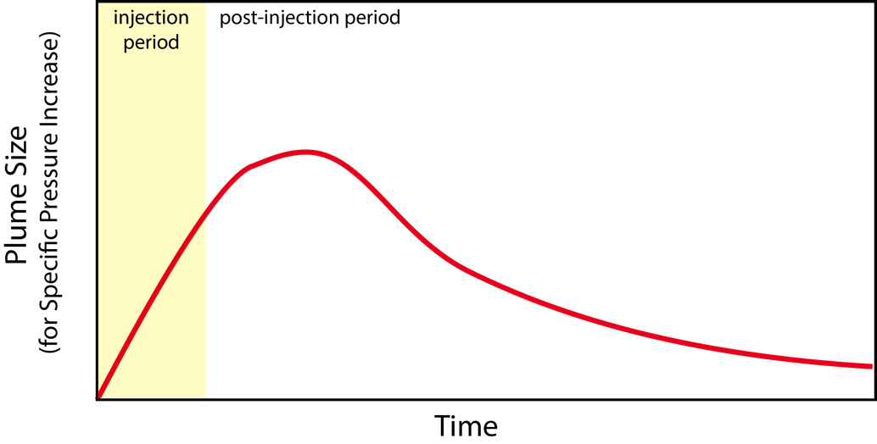
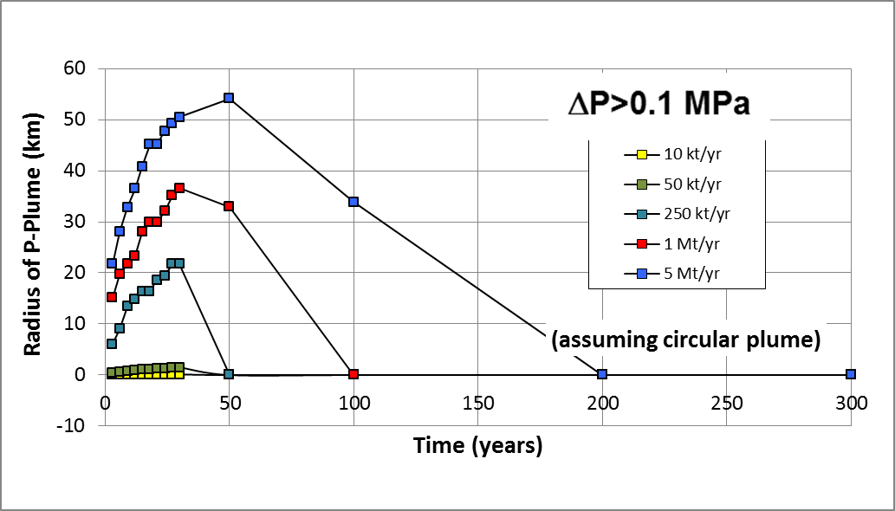
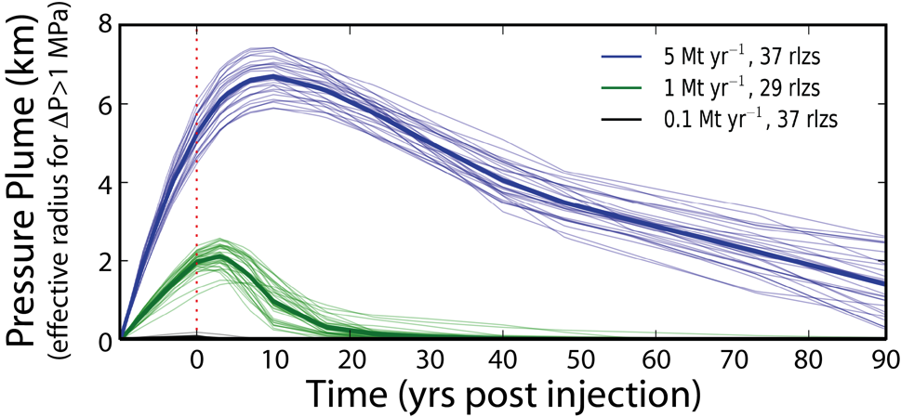
Growth of pressure plume has a characteristic behavior, albeit details vary between sites.
Unbound Sandstone, Regional Dip (0° dip)
post-injection: reaches maximum size;
slow decay
injection: rapid growth
Domal Sandstone-Limestone

Slide 10
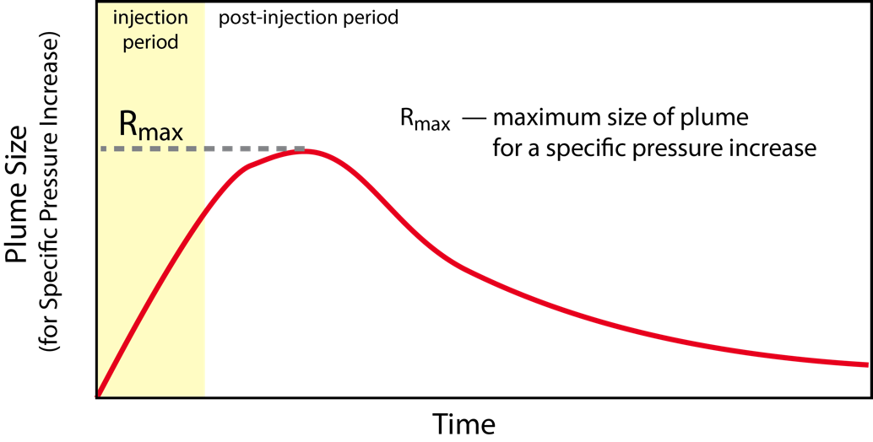
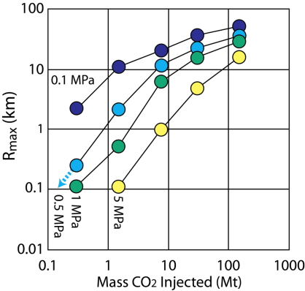
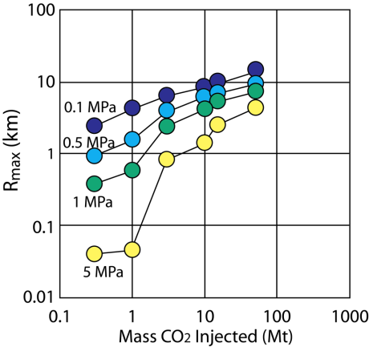
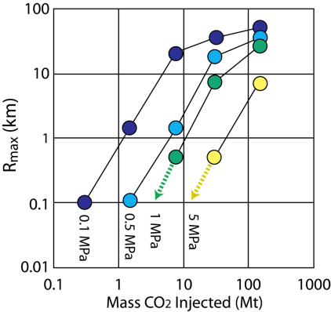
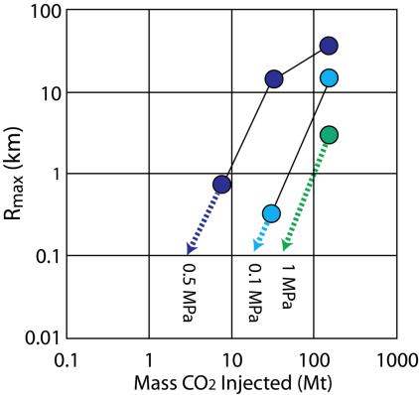
Amount of CO₂ injected and geologic details each impact the area/distance for pressure effects.
Unbound Sandstone, Regional Dip (0° dip)
Domal
Sandstone-Limestone
(k_{h}=10 mD)
Increase in mass of CO₂ increases the distance of pressure effects for a given threshold
Decreasing permeability can significantly increase distance (or size) of pressure effects
Increasing the permeability can dramatically decrease distance (or size) of pressure effects
operational
(k_{h}=100 mD)
(k_{h}=1000 mD)
geological

Slide 11
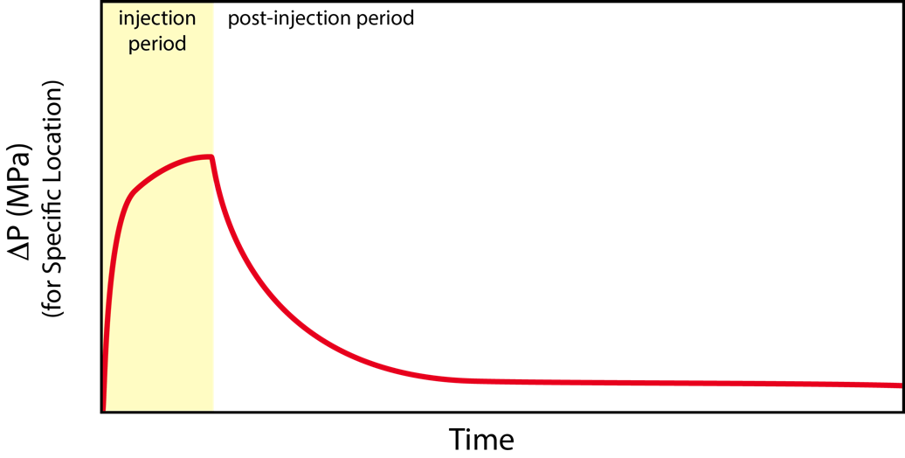
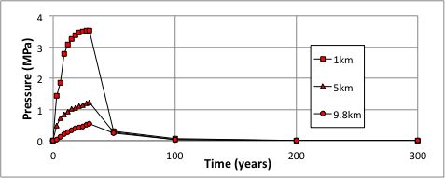
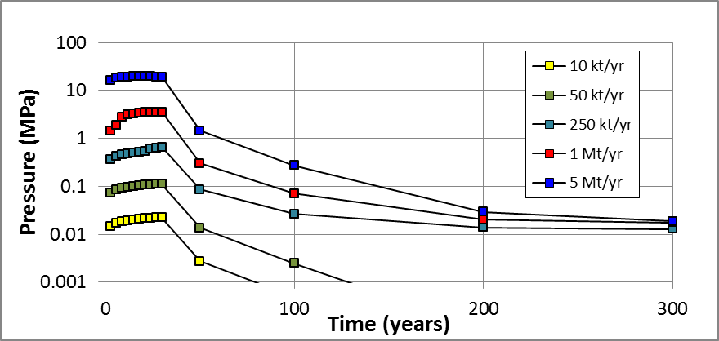
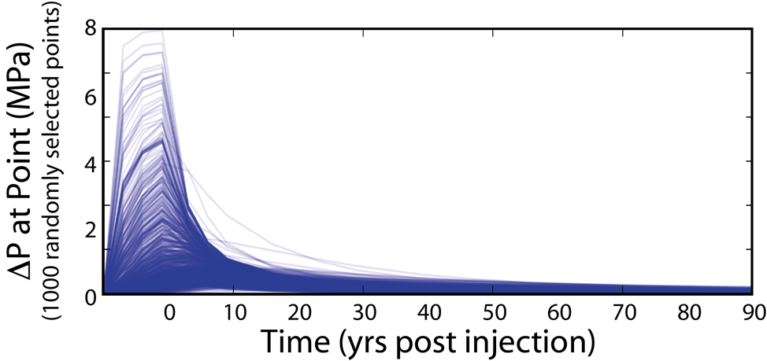
Pressure increase in reservoir has a characteristic behavior, albeit details vary between sites.
Unbound Sandstone, Regional Dip (0° dip; 1 Mt/yr)
Distance
from Injector
post-injection: rapid decay
injection: early rapid growth
Unbound Sandstone, Regional Dip (0° dip; @1 km)
Domal Sandstone-Limestone

Slide 12
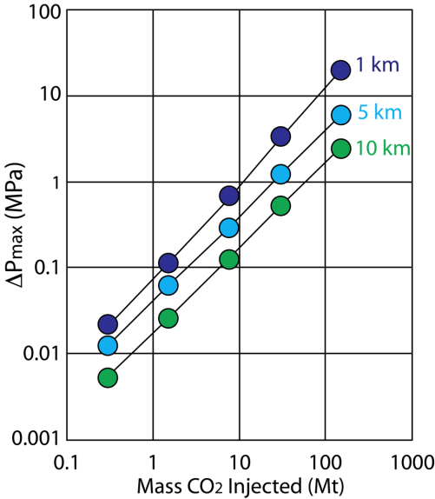

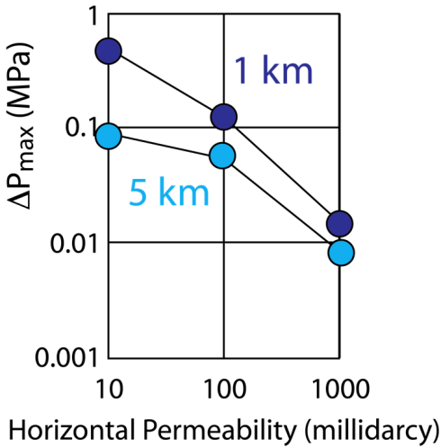
Amount of CO₂ injected and geologic details each impact the magnitude of pressure increase.
Unbound Sandstone, Regional Dip (0° dip)
Unbound Sandstone, Regional Dip
(1° dip; 1 Mt/yr)
Increase in mass injected increases maximum ΔP at a given distance from the injection well
Increase in permeability decreases maximum ΔP at a given distance from the injection well
operational
geological

Slide 13
General Observations
Two question
How does reservoir performance change as a function of injection volumes & rates?
How does a reservoir respond as a function of time when injection stops?
Impact of operational variables…
Reservoir response varies with amount of injected CO2
Size of CO2 Plume—rapid growth during injection; slower growth post injection
Size of Pressure Plume—rapid growth during injection; reaches maximum and decays post
Change in Pressure over Time—rapid growth during injection; rapid decline post injection
Potential to exceed some pressure thresholds depends on size of injection
Impact of geologic variables…
Reservoir response varies with geologic type
Rate of CO2 plume growth depends on reservoir porosity
Potential to exceed some pressure thresholds depends on reservoir permeability
Impact of geologic variables is on the same order as operational variables.

Slide 14
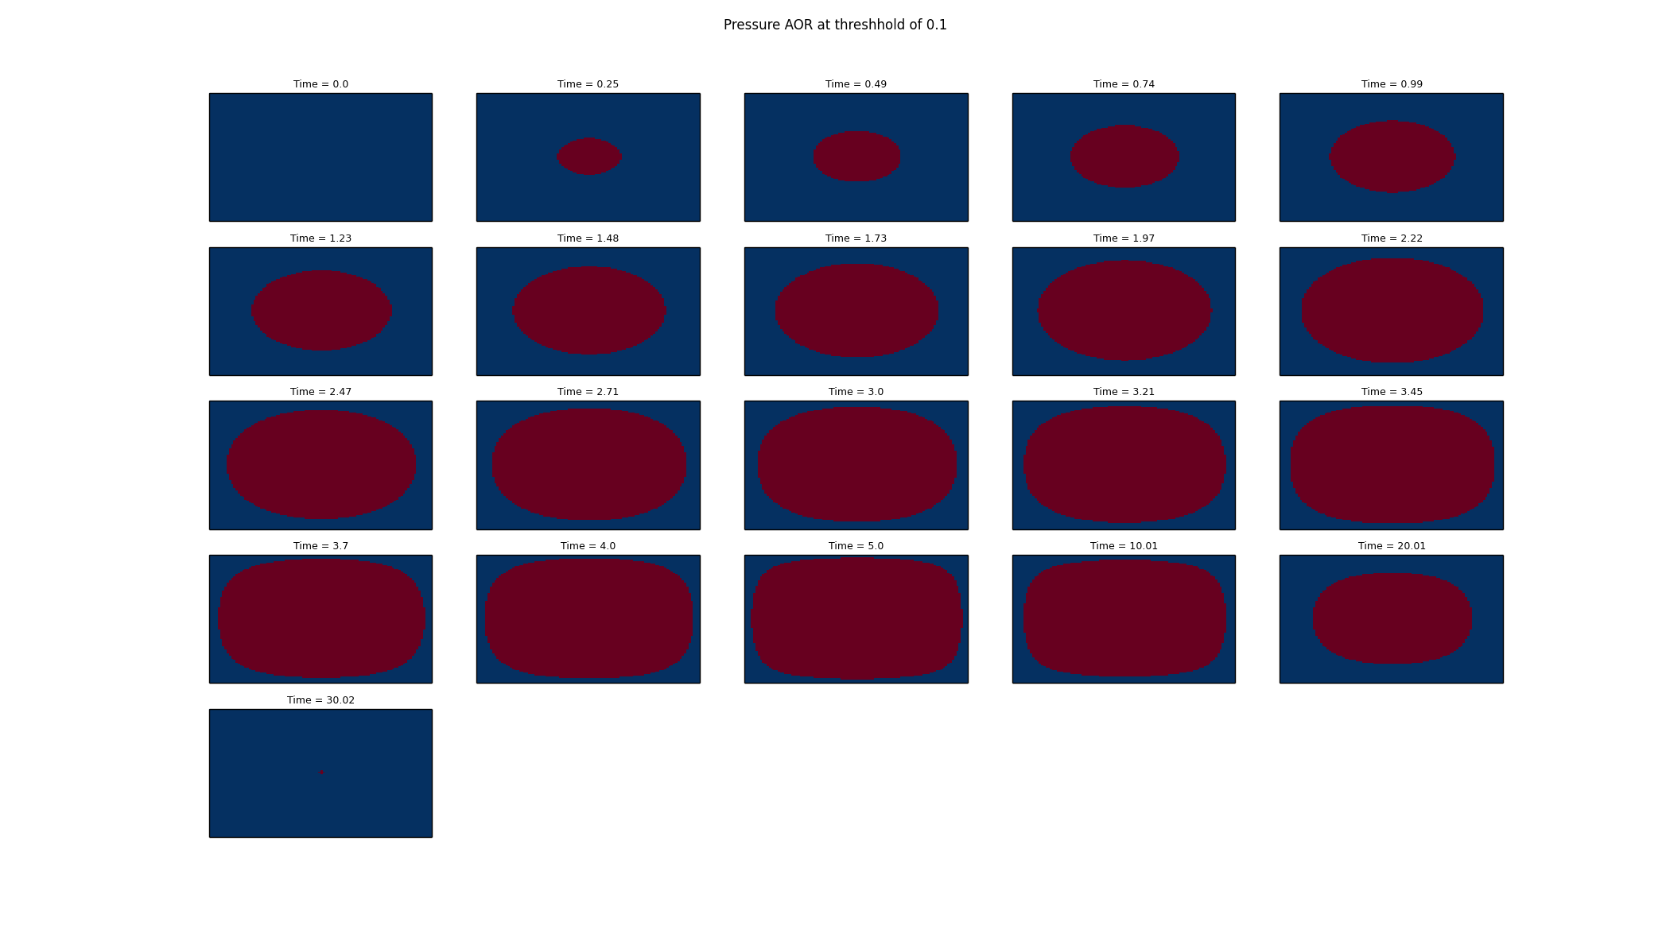
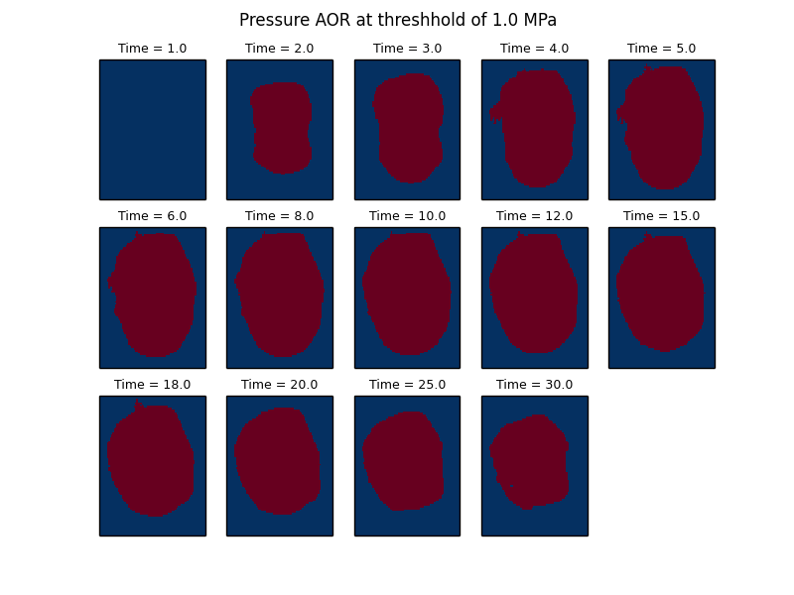
Reservoir Analysis Toolkit (RAT)
Takes in Pressure and Saturation values output from Simulation software (modular design accommodates different file types).
Outputs plume sizes through time and pressure values in specified grid blocks at each time step.
Scriptable to process multiple realizations.
Initial GUI interface developed (needs updated since new metrics introduced).

Slide 15
ROM Type: Surrogate Reservoir Model (SRM)
Reservoir Reduced Order Models (ROMs) for use with Integrated Assessment Models (IAMs)

Slide 16
What is an SRM?
Grid-Based SRM uses machine learning to train, calibrate, and validate a data-driven model capable of replicating the results of fluid flow through porous media in a simulation grid cell.
The data-driven model is trained to reproduce pressure or saturation changes within a simulation grid cell as a function of:
Reservoir Characteristics
Imposed Physics (multi-physics)
Operational Constraints
Applied Throughout the field
Main Grid
Above
North
East
West
South
Below

Slide 17
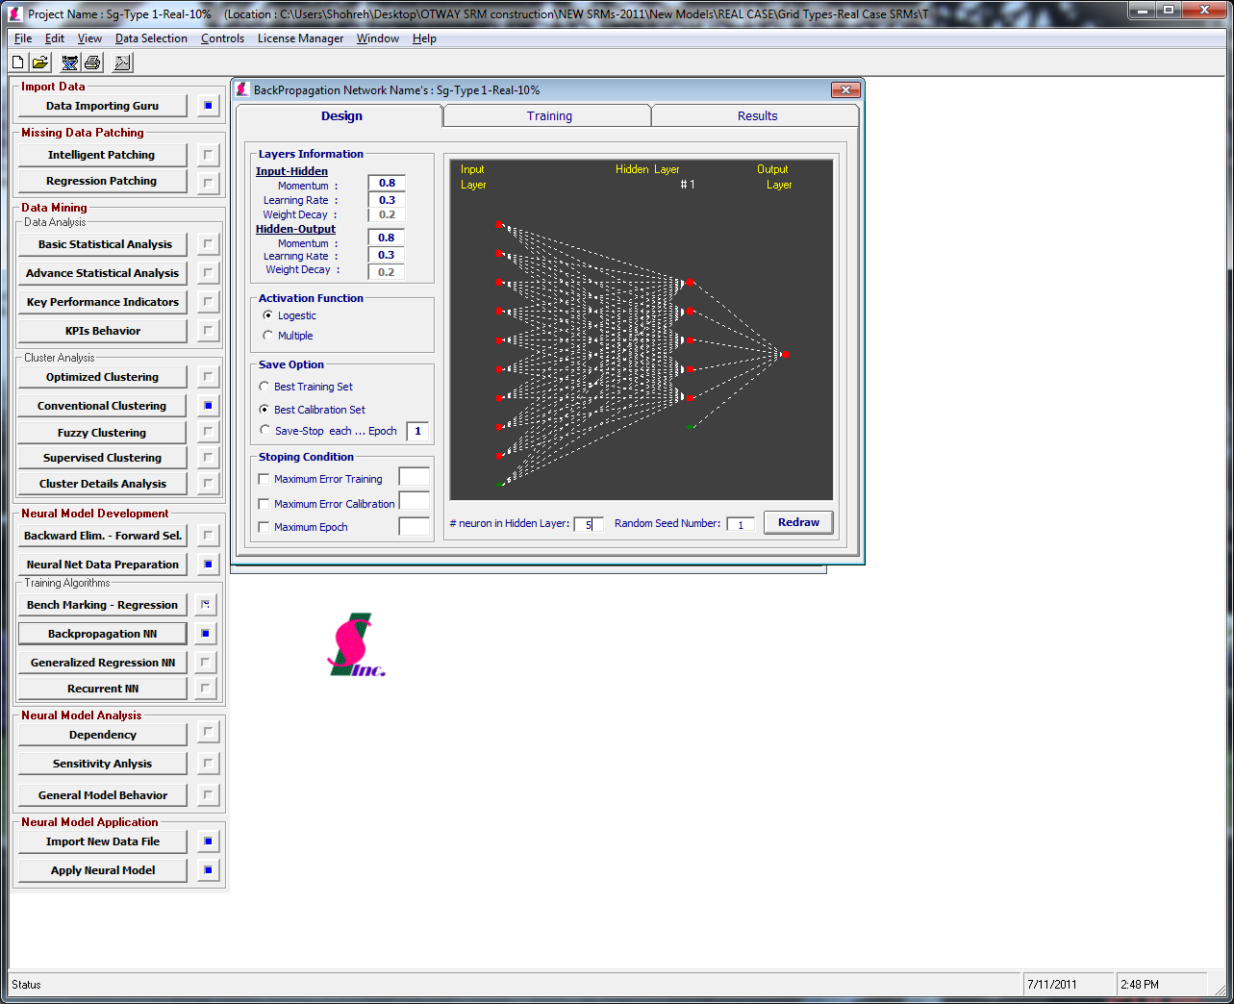
Steps involved in developing SRM
Steps
Generate a few initial simulations with full CMG reservoir model (18 simulations)
Create database of CMG inputs and outputs for each simulation
Select and organize data to ensure appropriate relationships between less or more distant neighbor cells are captured; generate SRM input
Train neural networks (here using 2% of the CMG input/output tables), calibrate, and verify for each parameter of interest
Apply neural networks to blind scenarios for testing
Different SRMs generated based on time period
During injection
Post-injection
Interpolation in space and time as in LUT
Spatially-varying porosity and permeability
Rate and duration of injection varied
Input Layer
Output Layer
Hidden Layer
Amini et al, 2011
Notes:
No physics included; just neural networks training
There are several neural networks for one specific type of locations (grid blocks); e.g., those close to the faults, close to injector, those farther away; etc.
Step 3 is about how to organize these neural networks
Training involves developing appropriate linkages between input and output (hidden layer); non-physical

Slide 18
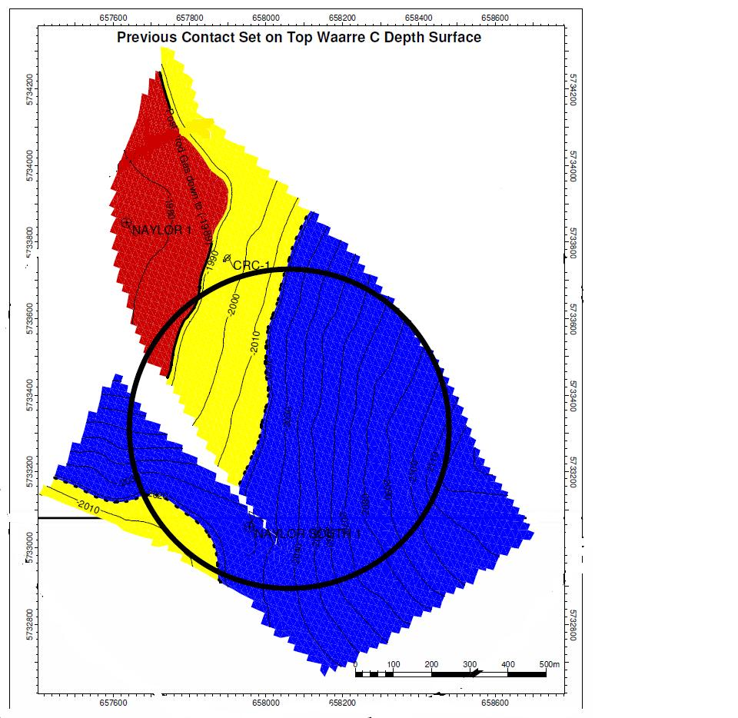
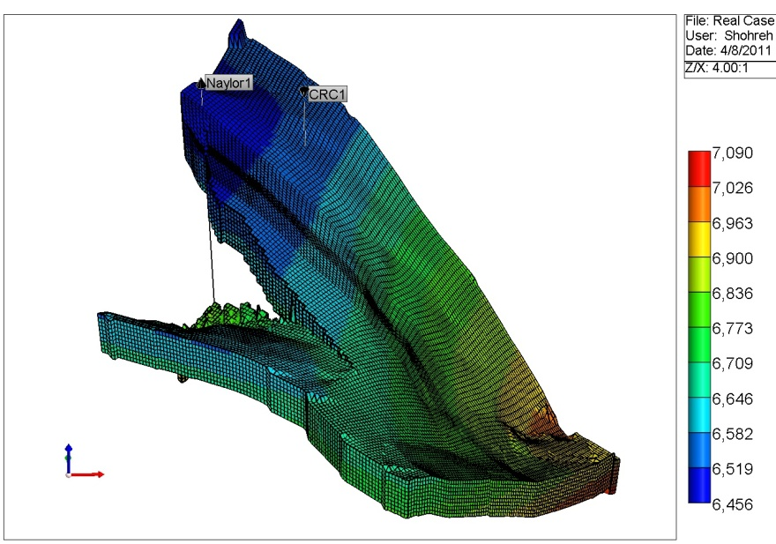
Reservoir model used for SRM development
Saline Sandstone Reservoir Within Depleted Gas Field
Based on actual CO₂ injection site in southern Australia
Simulations for moderate injection of 35,000-100,000 t CO₂ over 5 years
18 intermediate-scale CMG simulations performed with history-matched model
Surrogate model based on artificial intelligence and data mining approach using neural networks
Permeability and porosity vary spatially in each reservoir grid block
Monitoring Well
CO₂ Injection

Slide 19
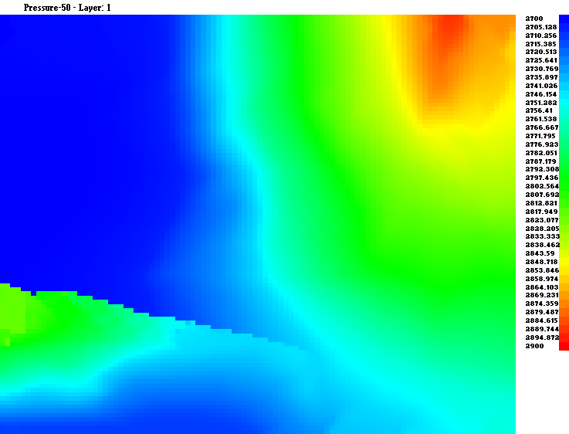
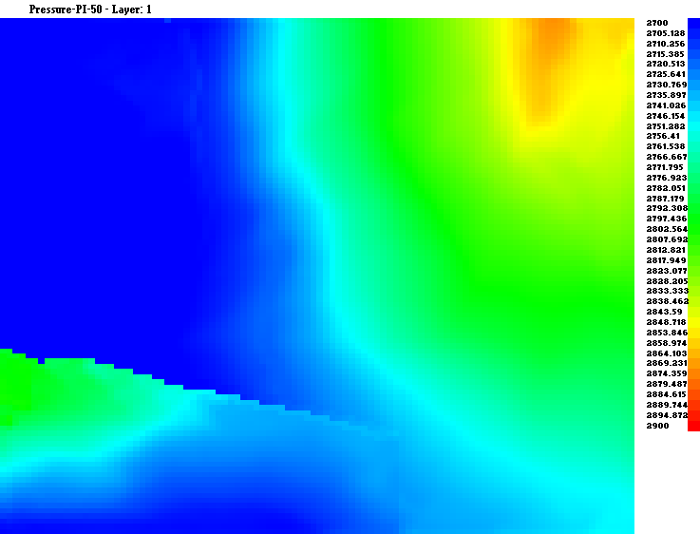
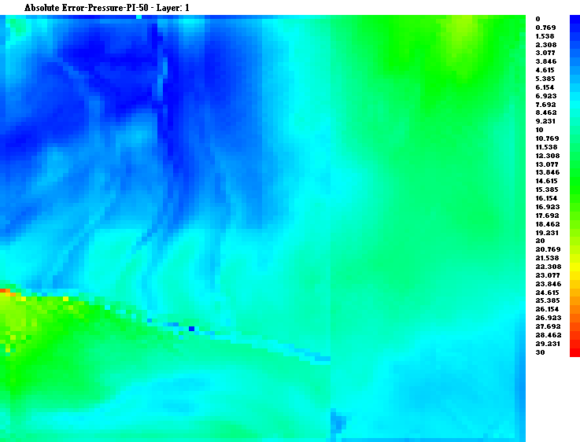
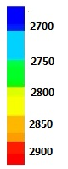
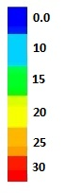
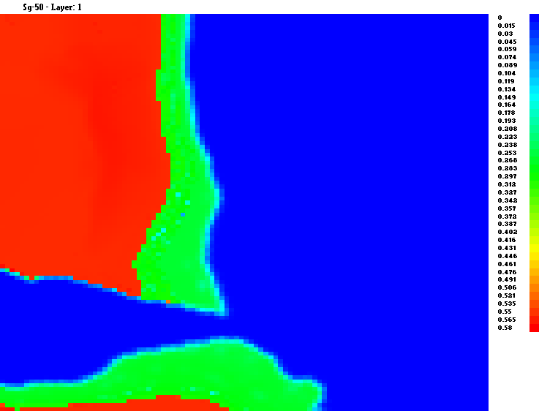
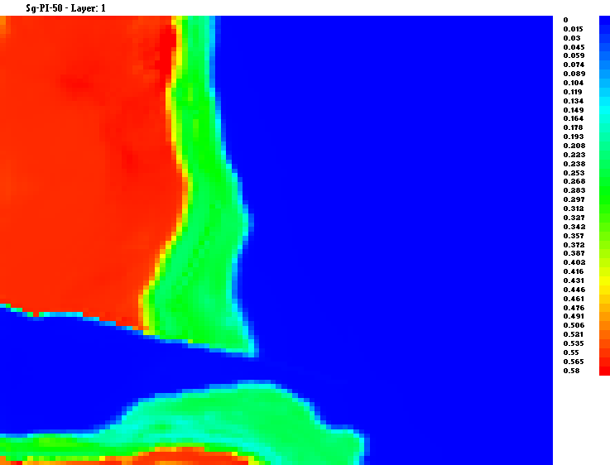
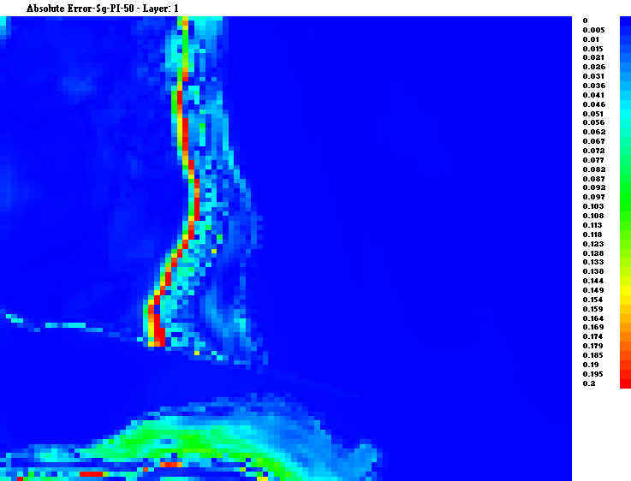
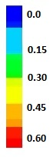
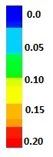
Surrogate models compare well to reservoir simulations
50 years after Injection
psi
psi
Fraction
CO2 Mole Fraction
Fraction

Slide 20
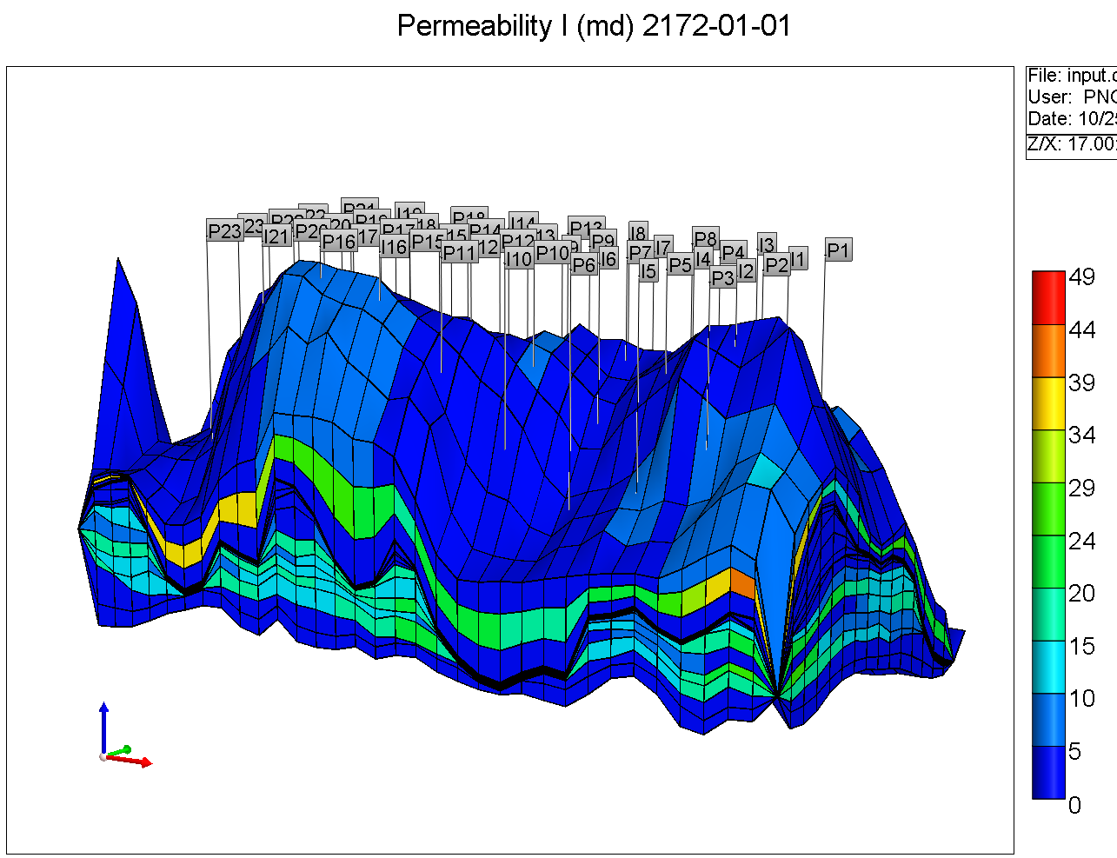
Second reservoir model for SRM development
Saline Sandstone Reservoir Within Depleted Gas Field
Based on actual EOR field in West Texas (40 years of CO₂ injection)
Upscaled porosity and permeability model (Han et al, 2008)
10 CMG simulations with history-matched model, begin after oil production completed
Allow injection for 50 years in several wells at a given wellhead pressure
Permeability and porosity vary spatially in each reservoir grid block
Porosity
Permeability

Slide 21
Surrogate models compare well to reservoir simulations
Simulator (CMG) Results
SRM (GRNN) Results
% Relative Error
Start of Simulation
Start of Injection
01/01/2172
End of Injection
01/01/2222
2172
2222
3172
9 yrs after Injection
01/01/2181

Slide 22
Summary for SRM technique
Type of reservoirs: Gas field, sandstone, moderate-high complexity
Oil field, sandstone, moderate complexity, many wells
ROM properties:
Requires few reservoir simulation runs (<15-20)
Good accuracy w.r.t. reservoir simulation (<5-10% error in 95-99% of cases)
Allows for spatial heterogeneity variability
Allows for operational variability (e.g., rate of injection, length of injection, bottomhole pressure)
Fast run time (~1 min for 10,000 grid blocks; ~10s for ~1,000 grid blocks)
Takes time to train SRM once reservoir simulation runs are complete (months; speed improves with practice)
SRM based on data collected post injection may not need any re-training, just updating of reservoir parameters used, if data is within envelope of predictions of initial SRMs

Slide 23
ROM Type: Polynomial Chaos Expansion (PCE)

Slide 24
What is the PCE technique?
permeability, porosity, etc
pressure,
gas saturation, etc
Numerical Simulation
Input
Output
Polynomial Chaos Expansions:
Spatially varied porosity and permeability
Used porosity and permeability in 6 nearest grid blocks for predictions
Varied bottomhole pressure in wells
Spatial and temporal discretization and interpolation as in LUT and SRM

Slide 25
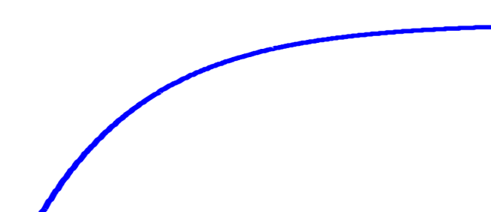
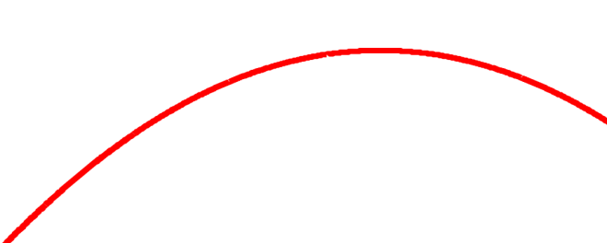
PCE technique uses mixed integer programming
Sample
d*, T*
Initialization at degree d = 0
Accuracy
Underfitting
Overfitting
Error_{d} small?
No
1
d = d + 1
R²
Cross validation
Solve a mixed-integer problem (MIP) for a best subset of bases functions
degree d
Terms T
Novelty of proposed PCE method:
Computationally efficient
Obtains simpler models
Overfitting?
Yes
Stop

Slide 26
Used same field for PCE and SRM
Saline Sandstone Reservoir Within Depleted Gas Field
Based on actual EOR field in West Texas (40 years of CO₂ injection)
Upscaled porosity and permeability model, 35x26 grid (Han et al, 2008)
10 CMG simulations with history-matched model, begin after oil production completed
Allow injection for 50 years in several wells at a given wellhead pressure
Permeability and porosity vary spatially in each reservoir grid block
Porosity
Permeability

Slide 27
Summary for PCE Method
Type of reservoir: Oil field, sandstone, moderate complexity, many wells
ROM properties:
Fast run times (~1s for ~1,000 grid blocks)
Used ~10-20 simulation runs (may require more runs to improve accuracy; sampling methods can help select runs needed)
Construction once reservoir simulation runs is relatively fast with MIP technique (1-2 weeks)
Allows for some operational parameter variability
Updating LUT based on data collected post injection requires re-running reservoir simulations and generating new ROMs
Questionable accuracy w.r.t. reservoir simulation for parameter combinations not explicitly trained for; issues with spatial heterogeneity or reservoir properties; did work well on a 2-D test case with homogeneous properties (<6% error)

Slide 28
Summary of ROM Approaches
The three types of ROMs each have their own distinct characteristics
Run time
Number of reservoir simulations needed
ROM development/training time
Flexibility
Accuracy
Different ROMs may be more suited for different applications or stages of a project:
LUT suitable for site characterization phase with large parameter uncertainty with highly unknown reservoir parameters
SRMs suitable for later project stage with partial history matching and uncertainty mainly in future injection rates and heterogeneous structure
PCE applicability similar to LUT with some additional flexibility for a larger number of input parameters, potentially spatially varying

